Slide 1
Insights for Revenue
and Expansion
TATA Insights and Quants
Data Analytics Team

Slide 2
The provided data required initial cleanup to ensure its quality, wherein we made sure that the minimum number of quantity being sold was at least 1. We also made sure that the unit price of the products was not below $0. There were also a few blanks in the product description column but with the help of stock code this was taken care of.
Apart from these the data is complete and accurate, and can answer the business questions concisely.

Slide 3
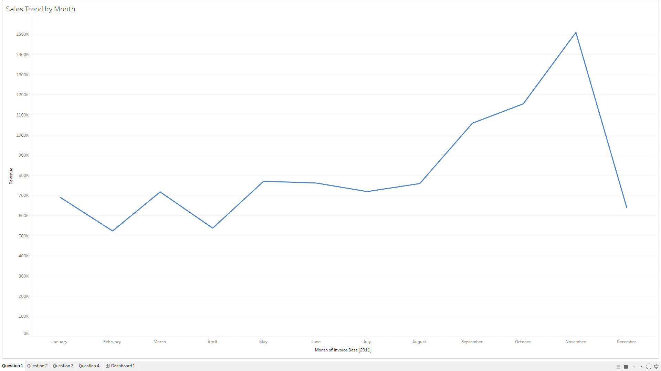
Revenue from January to August 2011: Steady between 500k to 800k.
Significant sales growth from September to November 2011: Increased from 800k to 1.5M.
December data insufficient for analysis.
Majority of revenue generated in the last 4 months of the year.
Notes:
The revenue in the starting months of year 2011 has been pretty much between 500k to 800k, but the sale started kicking off from the month of September and continued till the month of November from 800k all the way up till 1.5M, the data for December month was insufficient to obtain any insights from it. But this graph does show us one thing that most of the revenue that was generated is from the last 4 months of the year.

Slide 4
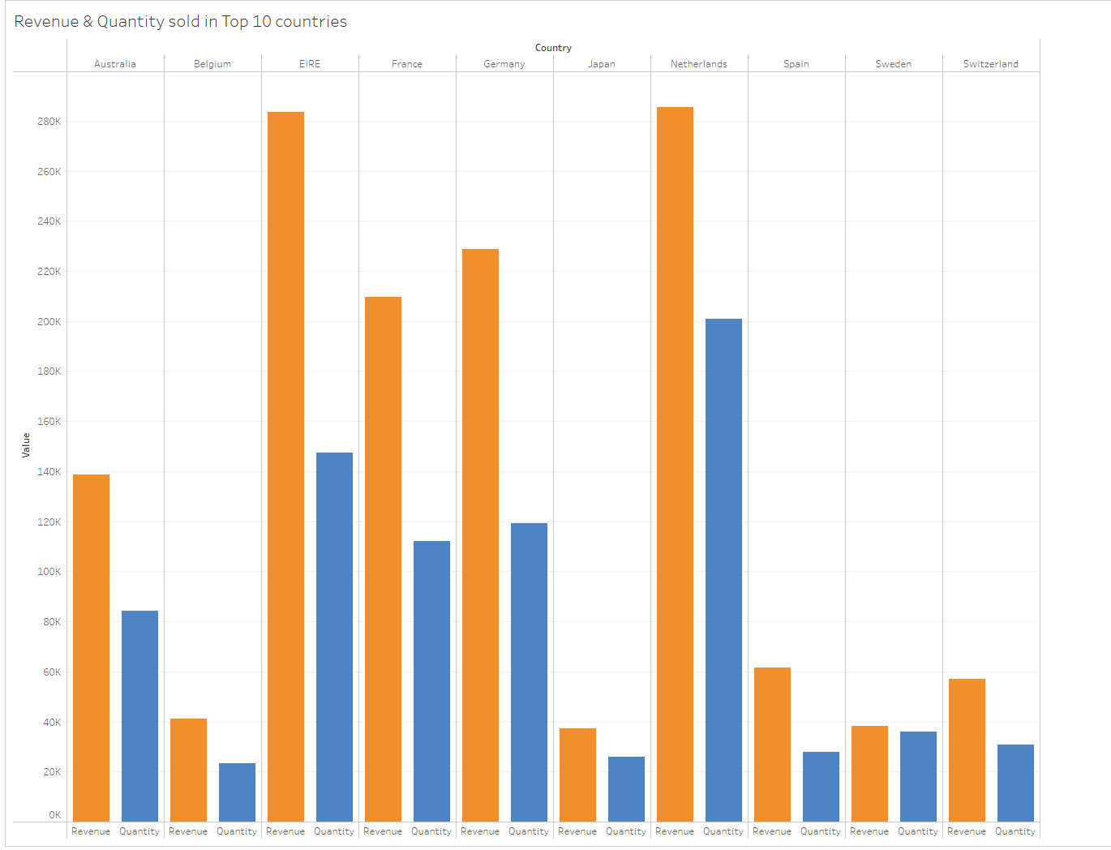
Graph shows Top 10 revenue-generating countries and number of products sold in each country.
Netherlands leads in revenue, followed by Ireland Germany and France.
Notably, Netherlands generated 285K revenue with over 200K+ products sold.
In contrast, Ireland generated 283K revenue with around 140K+ products sold.
These countries shows a potential for expansion to boost further Revenue.
Notes:
This data shows the top 10 countries generating highest revenues and the number of products sold in each country. The highest revenue generated was by Netherlands followed by Ireland, Germany and so on. The revenue of 285K in Netherlands was generated by selling 200k+ quantities of product, whereas Ireland generated a revenue of 283K by selling only around 140K+ quantities of products.
This shows that these countries are promising for an expansion to generate even higher revenue.

Slide 5
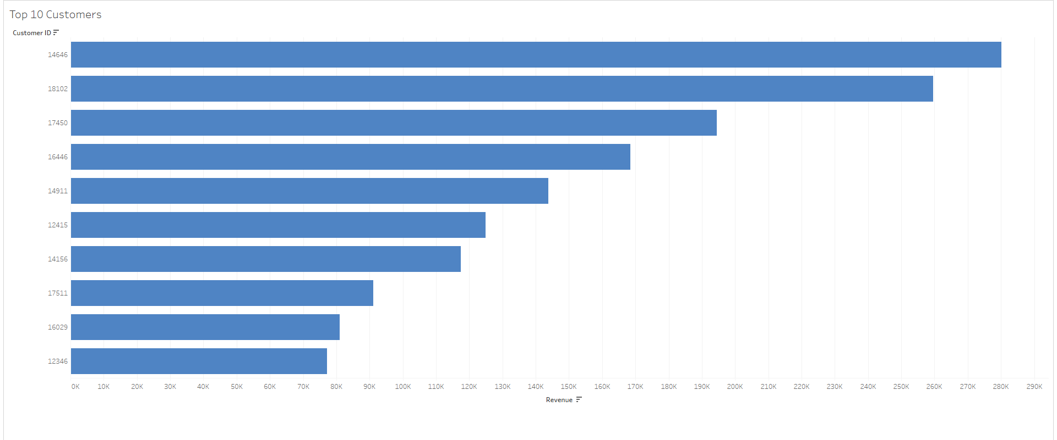
Top 10 revenue-generating customers displayed.
Customer ID 14646, from the Netherlands, tops the list with 280K in revenue.
Significant trust in our services shown by this customer.
The second-highest customer (ID 18102) generated around 260K, and the third-highest (ID 17450) brought in approximately 190K in revenue.
Notes:
This graph shows the top 10 customers generating the highest revenue.
The customer with ID 14646 generated the highest amount of revenue of 280k who is from Netherlands. Most of the revenue generated from Netherlands was from this one particular customer. This shows the amount of trust this customer has in us.
The revenue generated by 2nd highest customer with ID 18102 is around 260K followed by customer ID 17450 generating a revenue of around 190K.

Slide 6
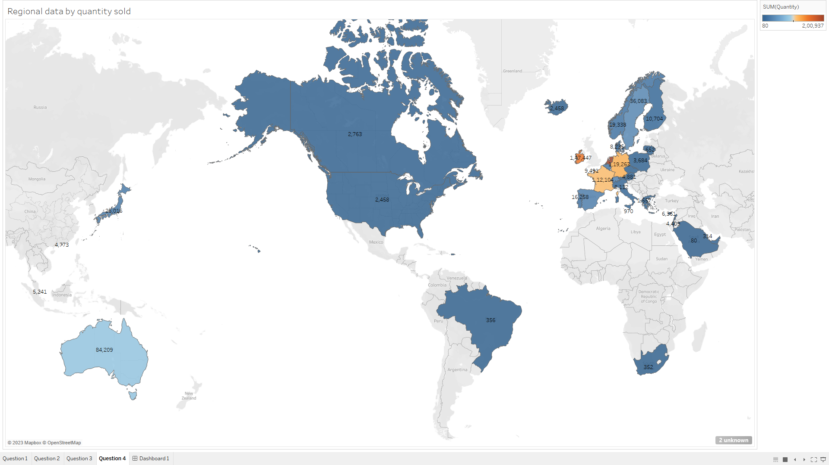
This heated map shows the counties with highest number of products being sold.
Netherlands Tops this list and it shows us room for expansion to this country.
Countries like Ireland, Germany and France also show a positive sign for expansion.
Tapping into these marketplaces would potentially generate us higher revenue in the future.
Notes:
This heated map shows the counties with highest number of products being sold. Netherlands Tops this list and it shows us room for expansion to this country, Countries like Ireland, Germany and France also show a positive sigh for expansion. Tapping into these marketplaces would potentially generate us higher revenue in the future.

Slide 7
Thank You!

